Slide 1
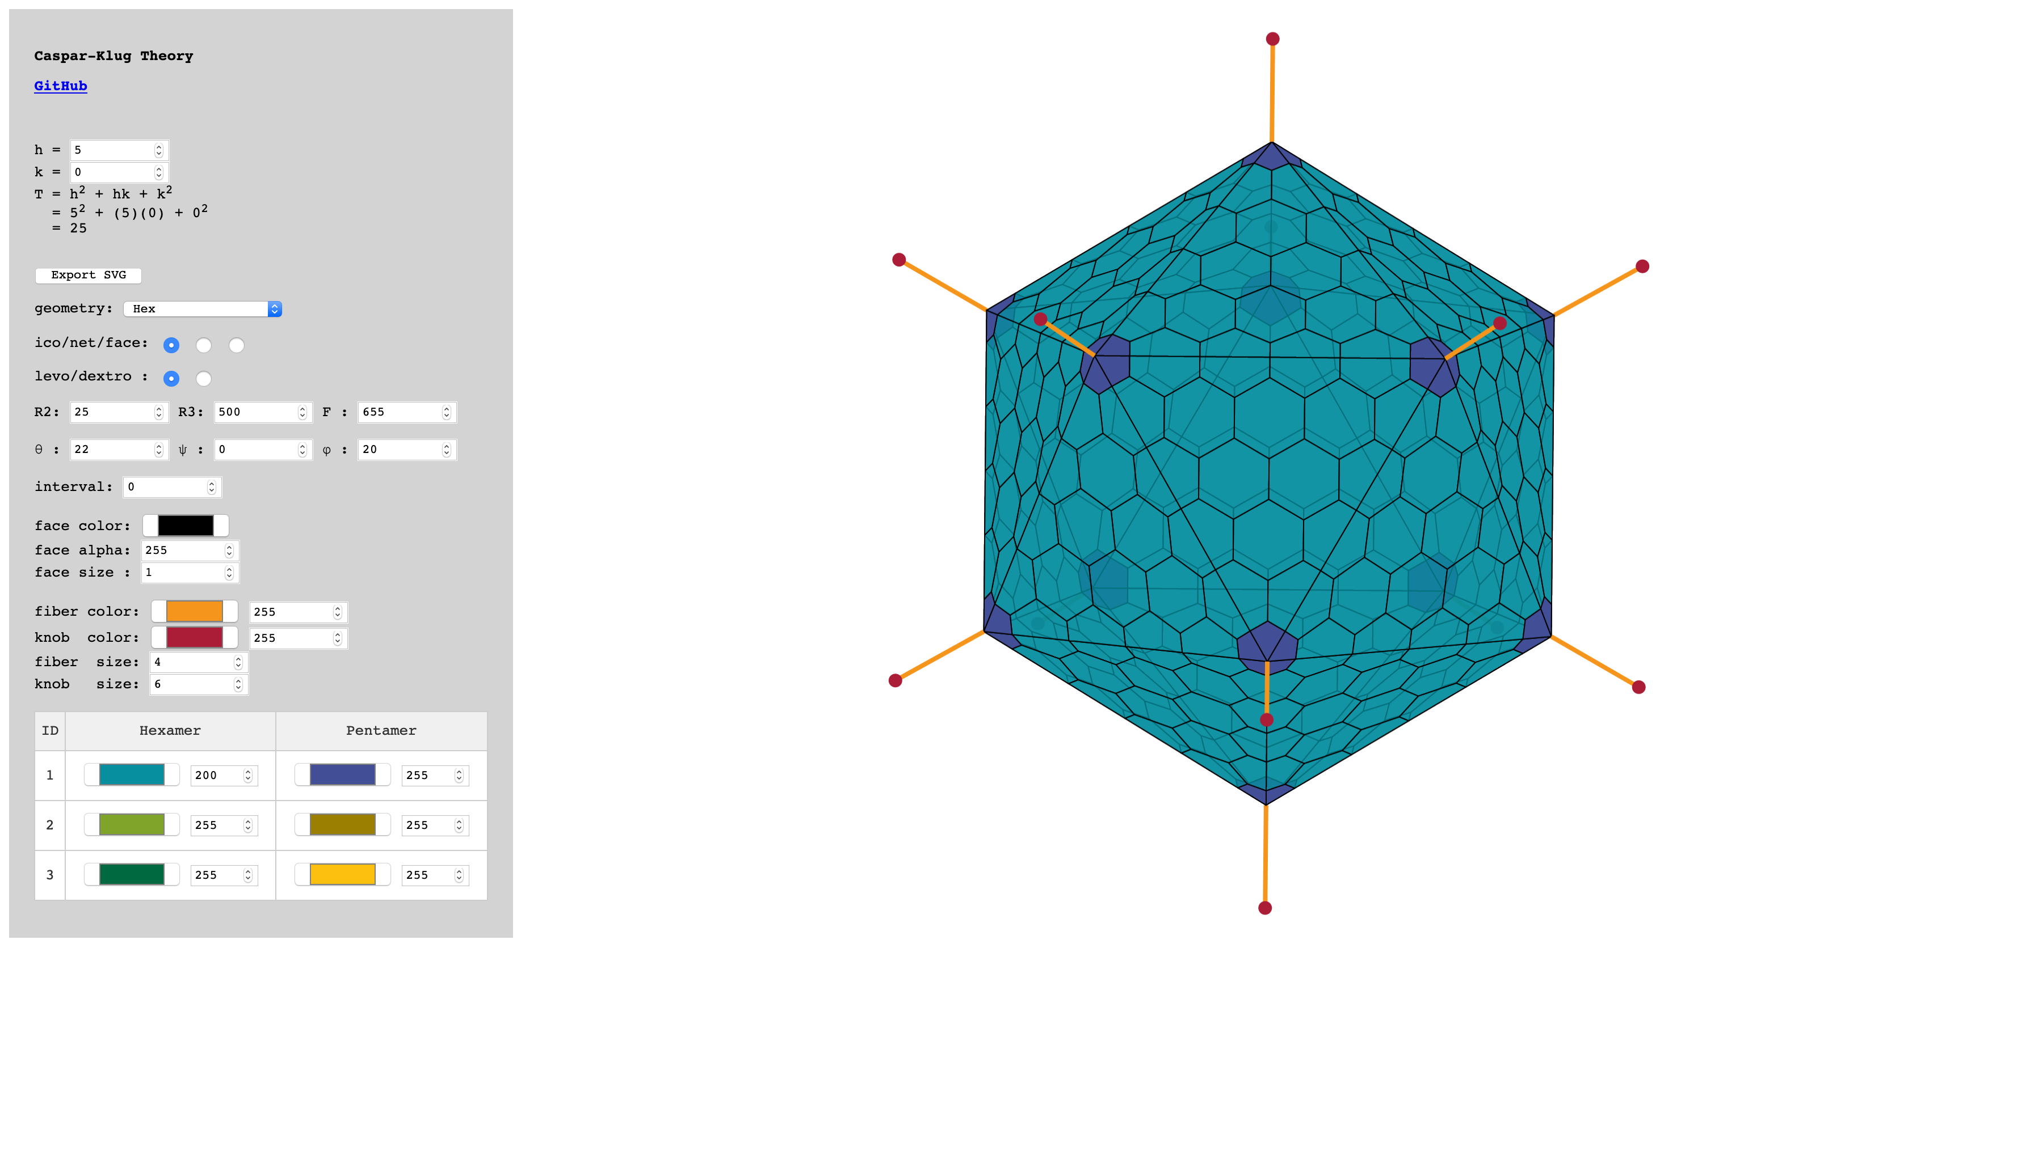
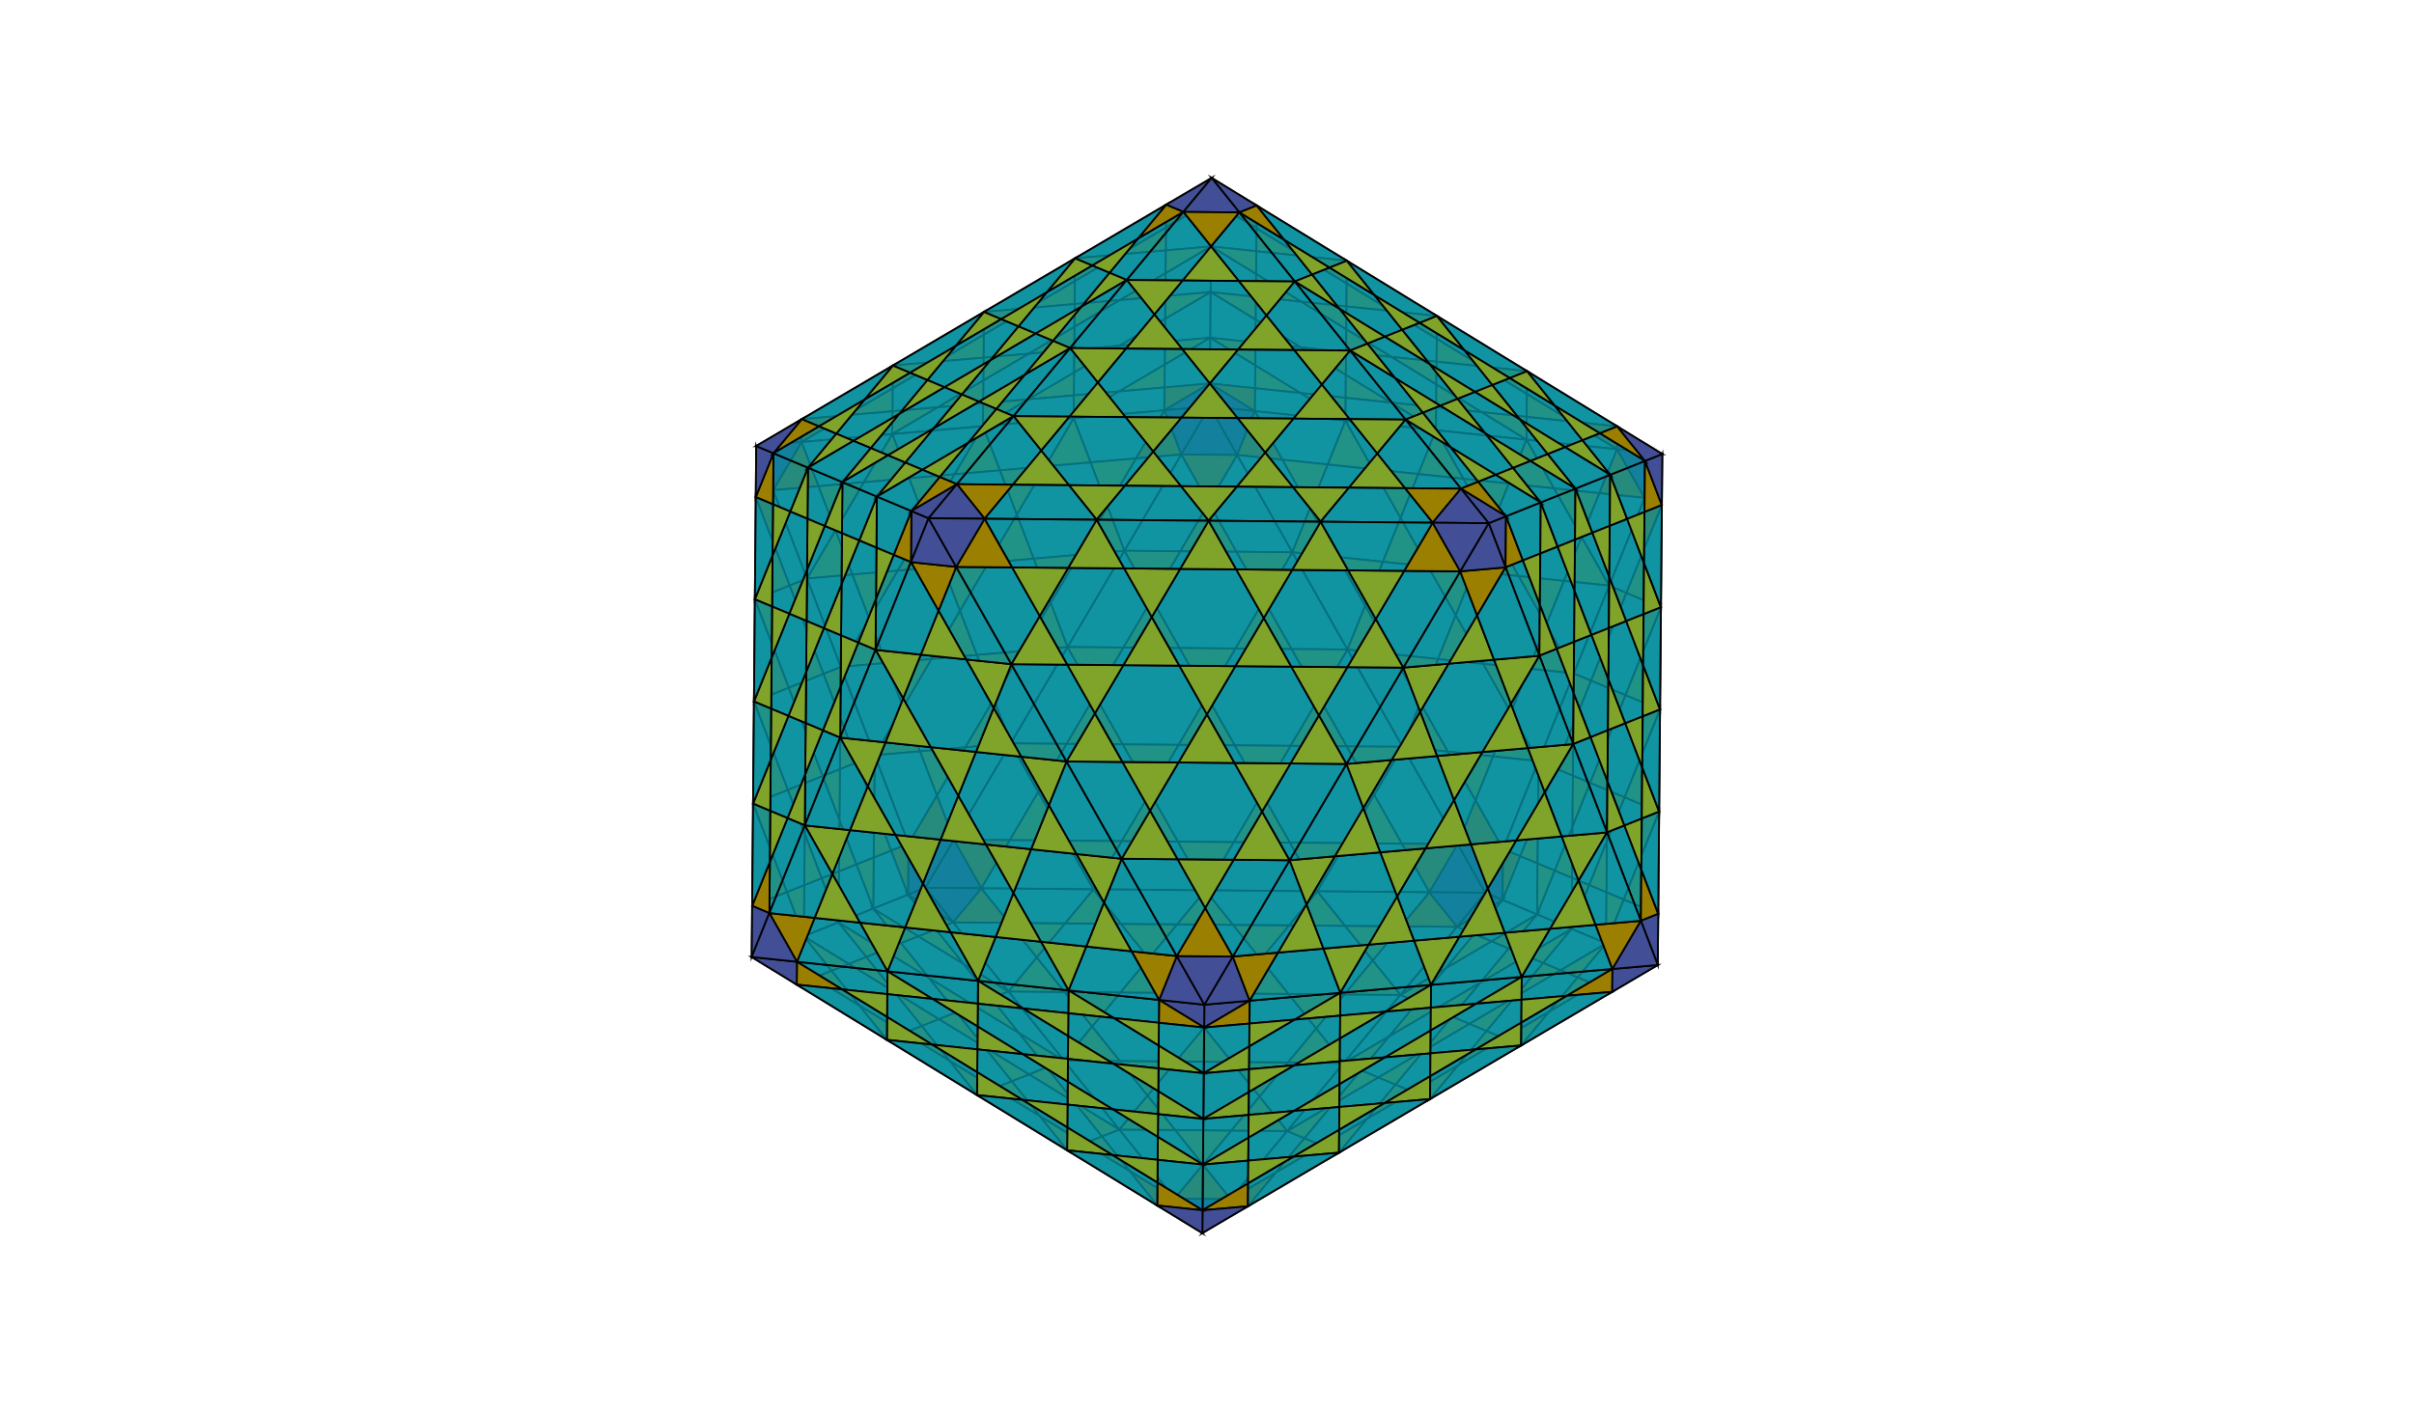
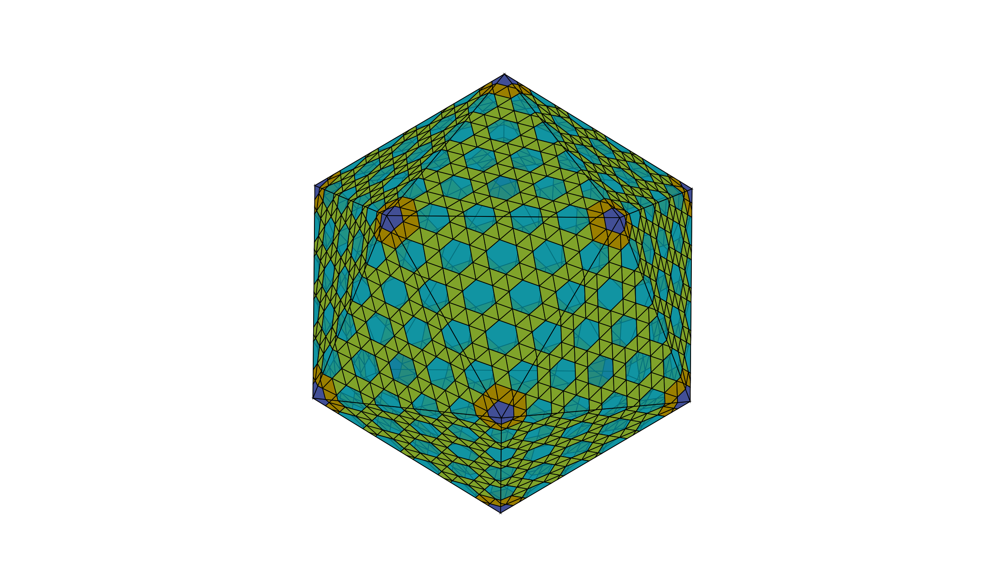
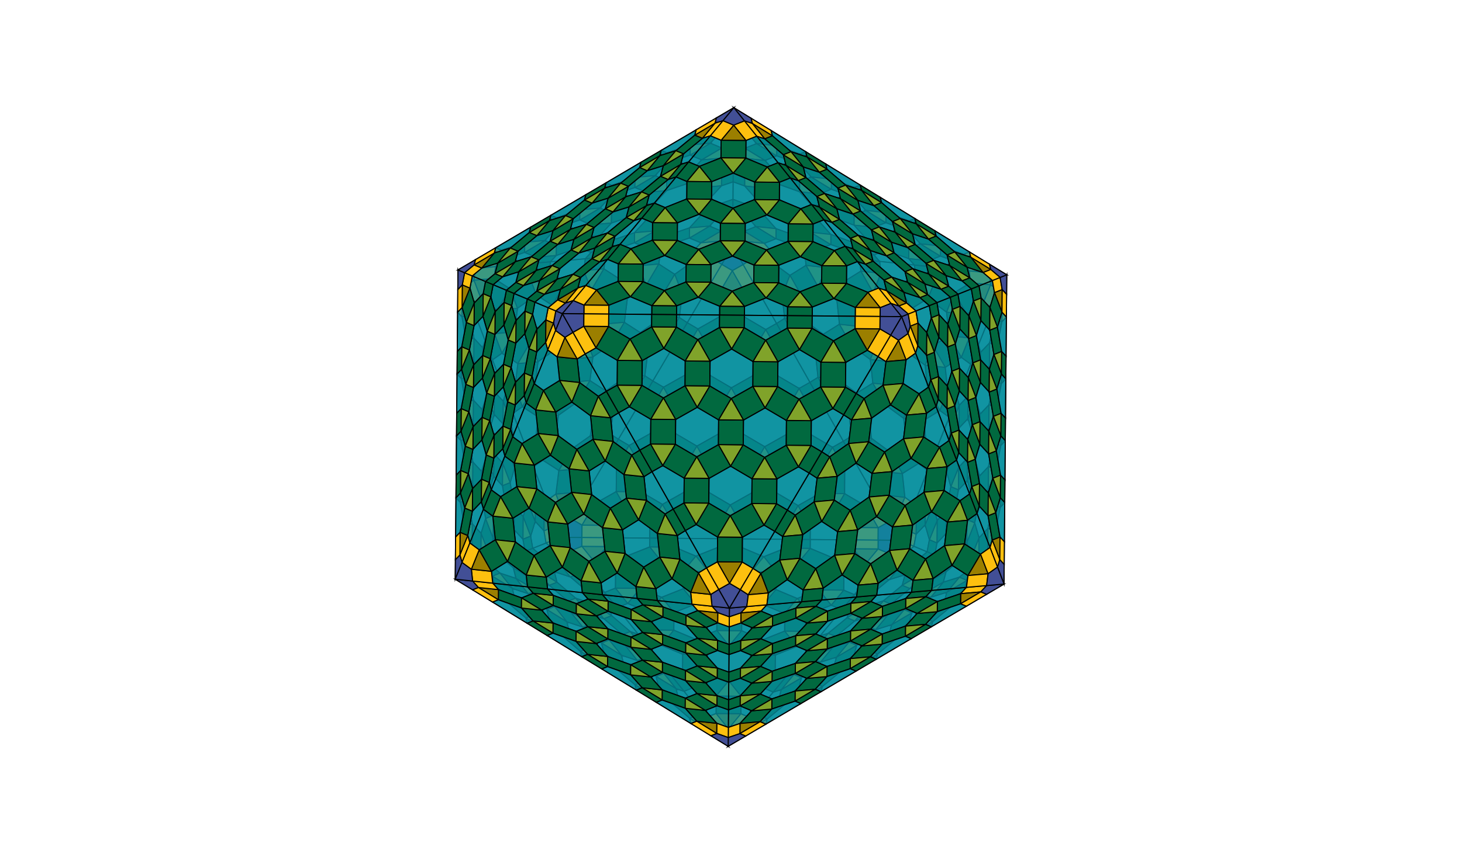
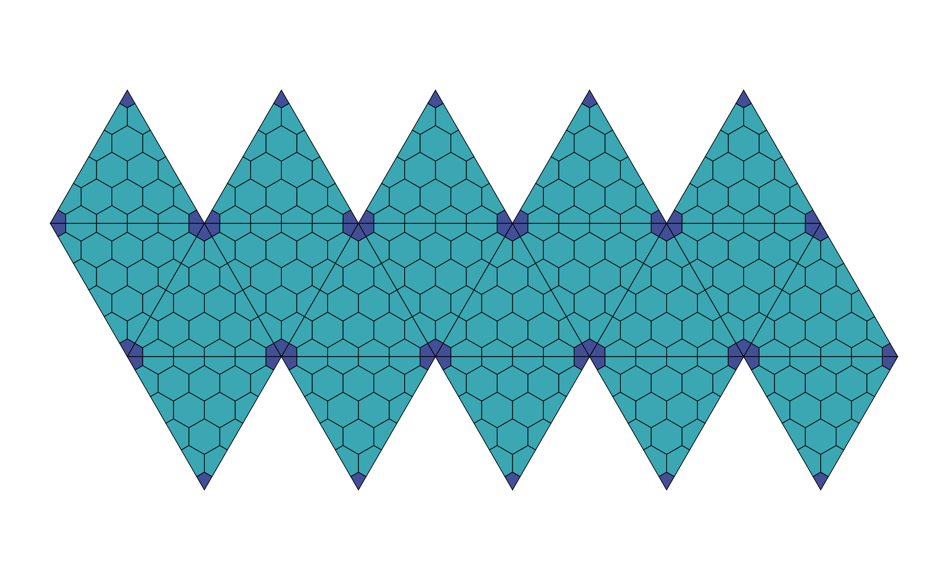
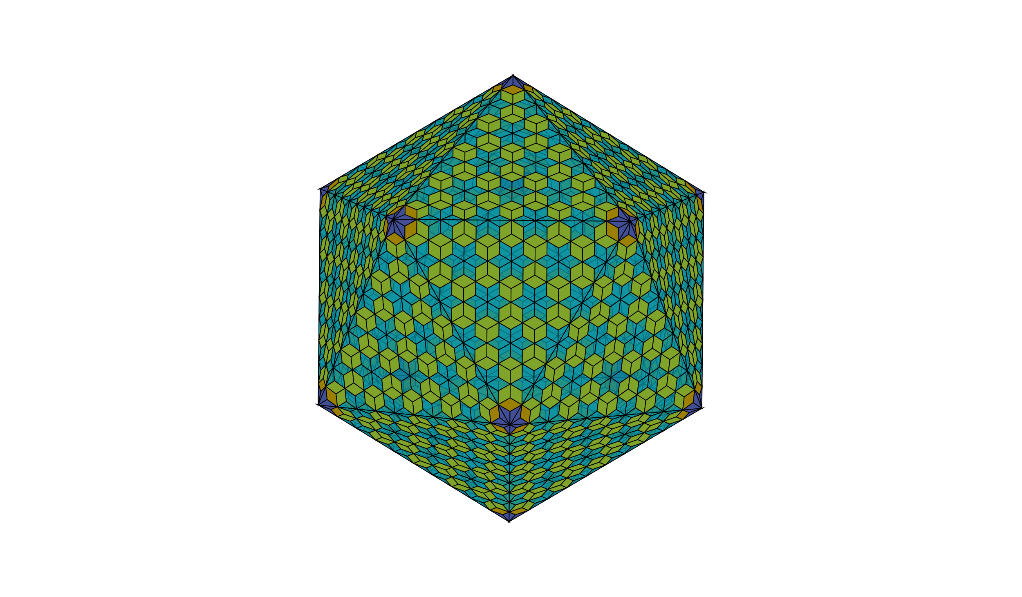
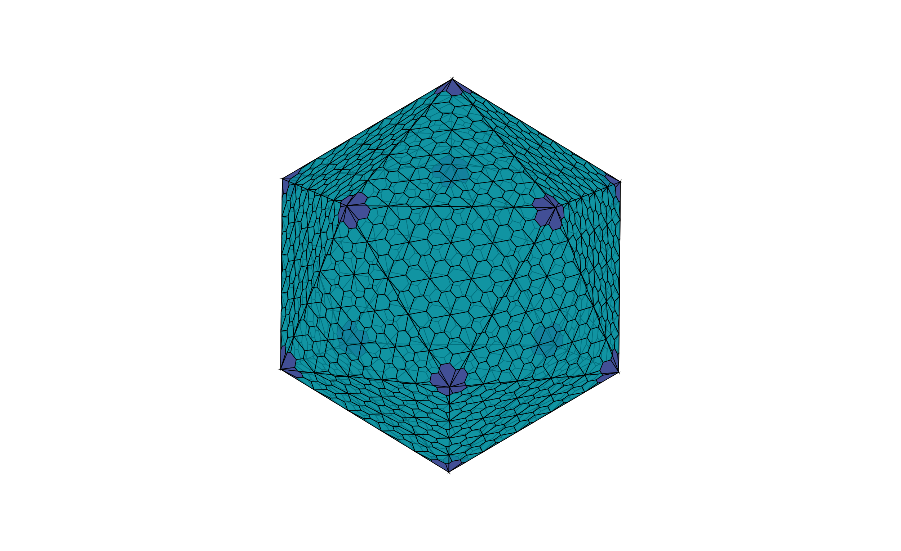
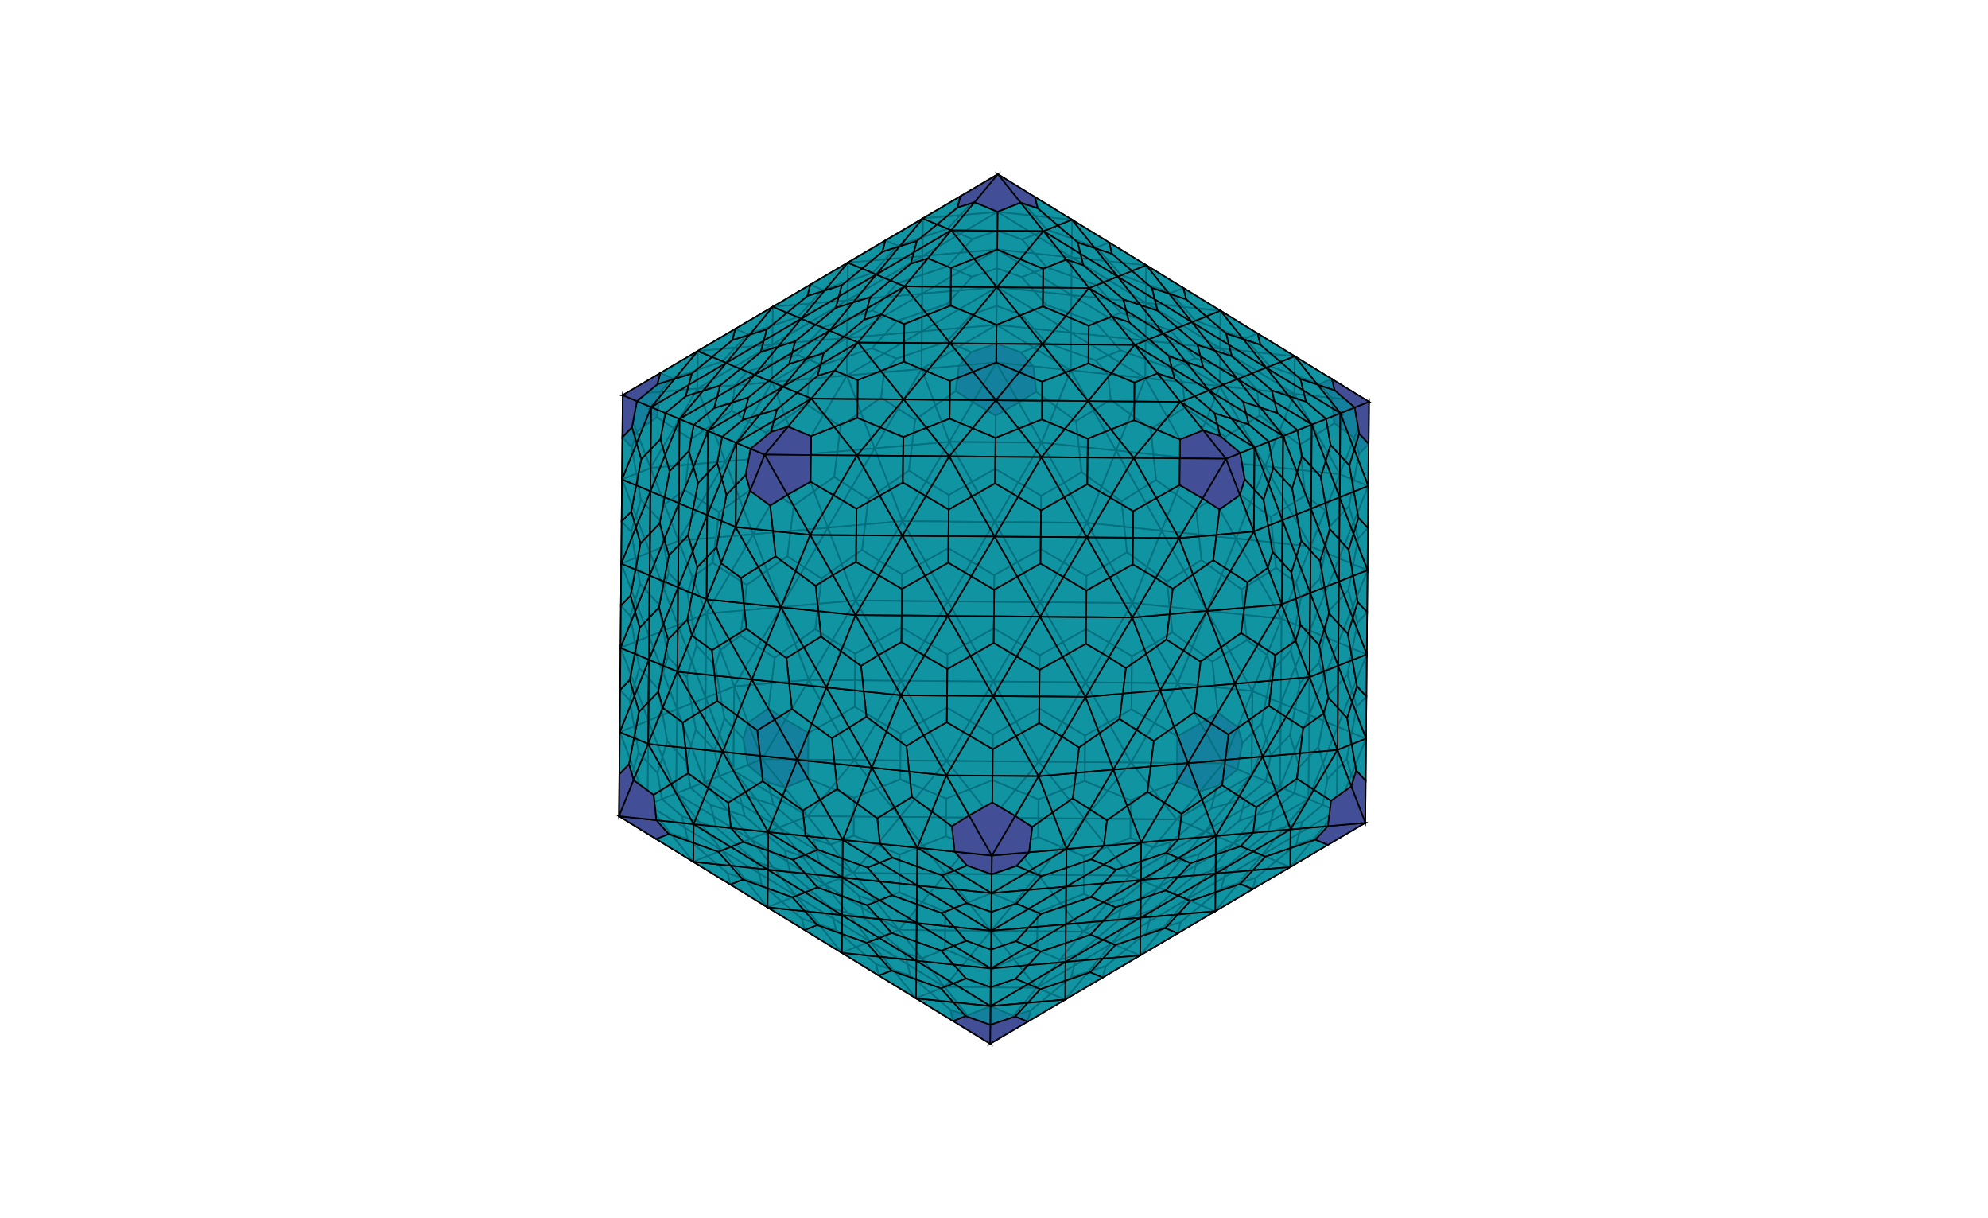
Vectorized Capsid Generation in the Browser
Daniel Antonio Negrón, PhD-c; George Mason University, School of Systems Biology
[ Introduction ]
[ Methods ]
This work implements Caspar-Klug Theory to generate high-quality, vectorized capsid cartoons in the browser. This is the first online tool that provides comprehensive style customization, geometry, and SVG export. The code and beta application are available under the MIT License:
https://github.com/dnanto/capsid
https://dnanto.github.io/capsid/capsid.html
1. Tessellation
2. H/K Walk
3. Extract/Color
4. Icosahedral Projection
Compute tessellation unit
Generate grid based on the tessellation geometry
Move h units
Turn levo or dextro
Move k units
T = h² + hk + k²
= 2² + (2)(1) + 1² = 7
Compute camera matrix
Compute 3D unit icosahedron coordinates
Sort faces by z-order
Project each face to 2D
Affine transform each face
[ Results ]
The app renders class I icosahedra and nets. It includes geometry for viruses with exotic lattice structures. Originally, the app was adenovirus-focused, so it retains the option of rendering a fiber protein at each vertex. Next steps include improvements to rendering time, inclusion of class II and III capsids, and prolate/oblate structures.
Options
Icosahedron
Net
Trihexagonal
Snub Trihexagonal
Rhombitrihexagonal
Non-Dual
Dual
[ References ]
[ Acknowledgements ]
Caspar, D. L., and A. Klug. “Physical Principles in the Construction of Regular Viruses.” Cold Spring Harbor Symposia on Quantitative Biology 27 (1962): 1–24. https://doi.org/10.1101/sqb.1962.027.001.005.
Prasad, B. V. Venkataram, and Michael F. Schmid. “Principles of Virus Structural Organization.” Viral Molecular Machines 726 (November 8, 2011): 17–47. https://doi.org/10.1007/978-1-4614-0980-9_3.
San Martín, Carmen. “Latest Insights on Adenovirus Structure and Assembly.” Viruses 4, no. 5 (2012): 847–77. https://doi.org/10.3390/v4050847.
Šiber, Antonio. “Icosadeltahedral Geometry of Geodesic Domes, Fullerenes and Viruses: A Tutorial on the T-Number.” Symmetry 12, no. 4 (April 2020): 556. https://doi.org/10.3390/sym12040556.
Twarock, Reidun, and Antoni Luque. “Structural Puzzles in Virology Solved with an Overarching Icosahedral Design Principle.” Nature Communications 10, no. 1 (September 27, 2019): 4414. https://doi.org/10.1038/s41467-019-12367-3.
Paperjs/Paper.Js. JavaScript. 2011. Reprint, Paper.js, 2020. https://github.com/paperjs/paper.js.
Dissertation committee:
Dr. Donald Seto (chair)
Dr. Patrick Gillevet
Dr. Sterling Thomas

